Slide 1
Business collections classification
The impact of restructured
"use context" and "notation type"

Slide 2
What and why?
Business Collections in
  Cellar & METS
  EU Vocabulary
  Harmonized codes
    In the impact assessment
    in the MDR workflow
Used resources (input)
  Use context
  Notation type
  Vocabulary table

Slide 3
How?
Design unified organization of the (use) contexts
(for model clarity)
  Domain & subdomain
  Information System
  Models/Schemas & Notations
Maintain separation of the two NALs
(for backwards compatibility and implementation/usage clarity)
  Use context table
    Domain & subdomain
    Information System
    Models/Schemas
  Notation type table
    Notations

Slide 4
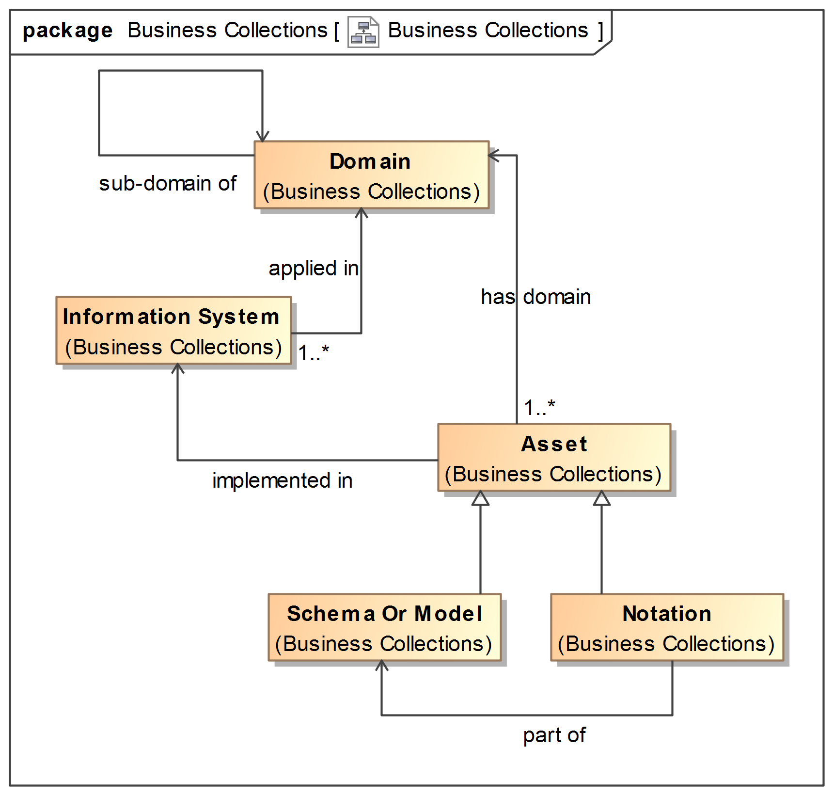
The unified model

Slide 5
To be done
Revise and Consolidate the unified model
  The model (iteratively as we progress) [EC]
  The content (definitions, labels, curation) [TT,EI]
    In a unified table or final separated tables
  Mappings with current values [TT,EI]
Update the current tables
  What about the workflow? [HK,JS]
  Separate the unified content into corresponding tables [HK,JS]
Start injecting metadata into METS packages [HK]
Display on EU Vocabularies website [EC,HK]

